Slide 1
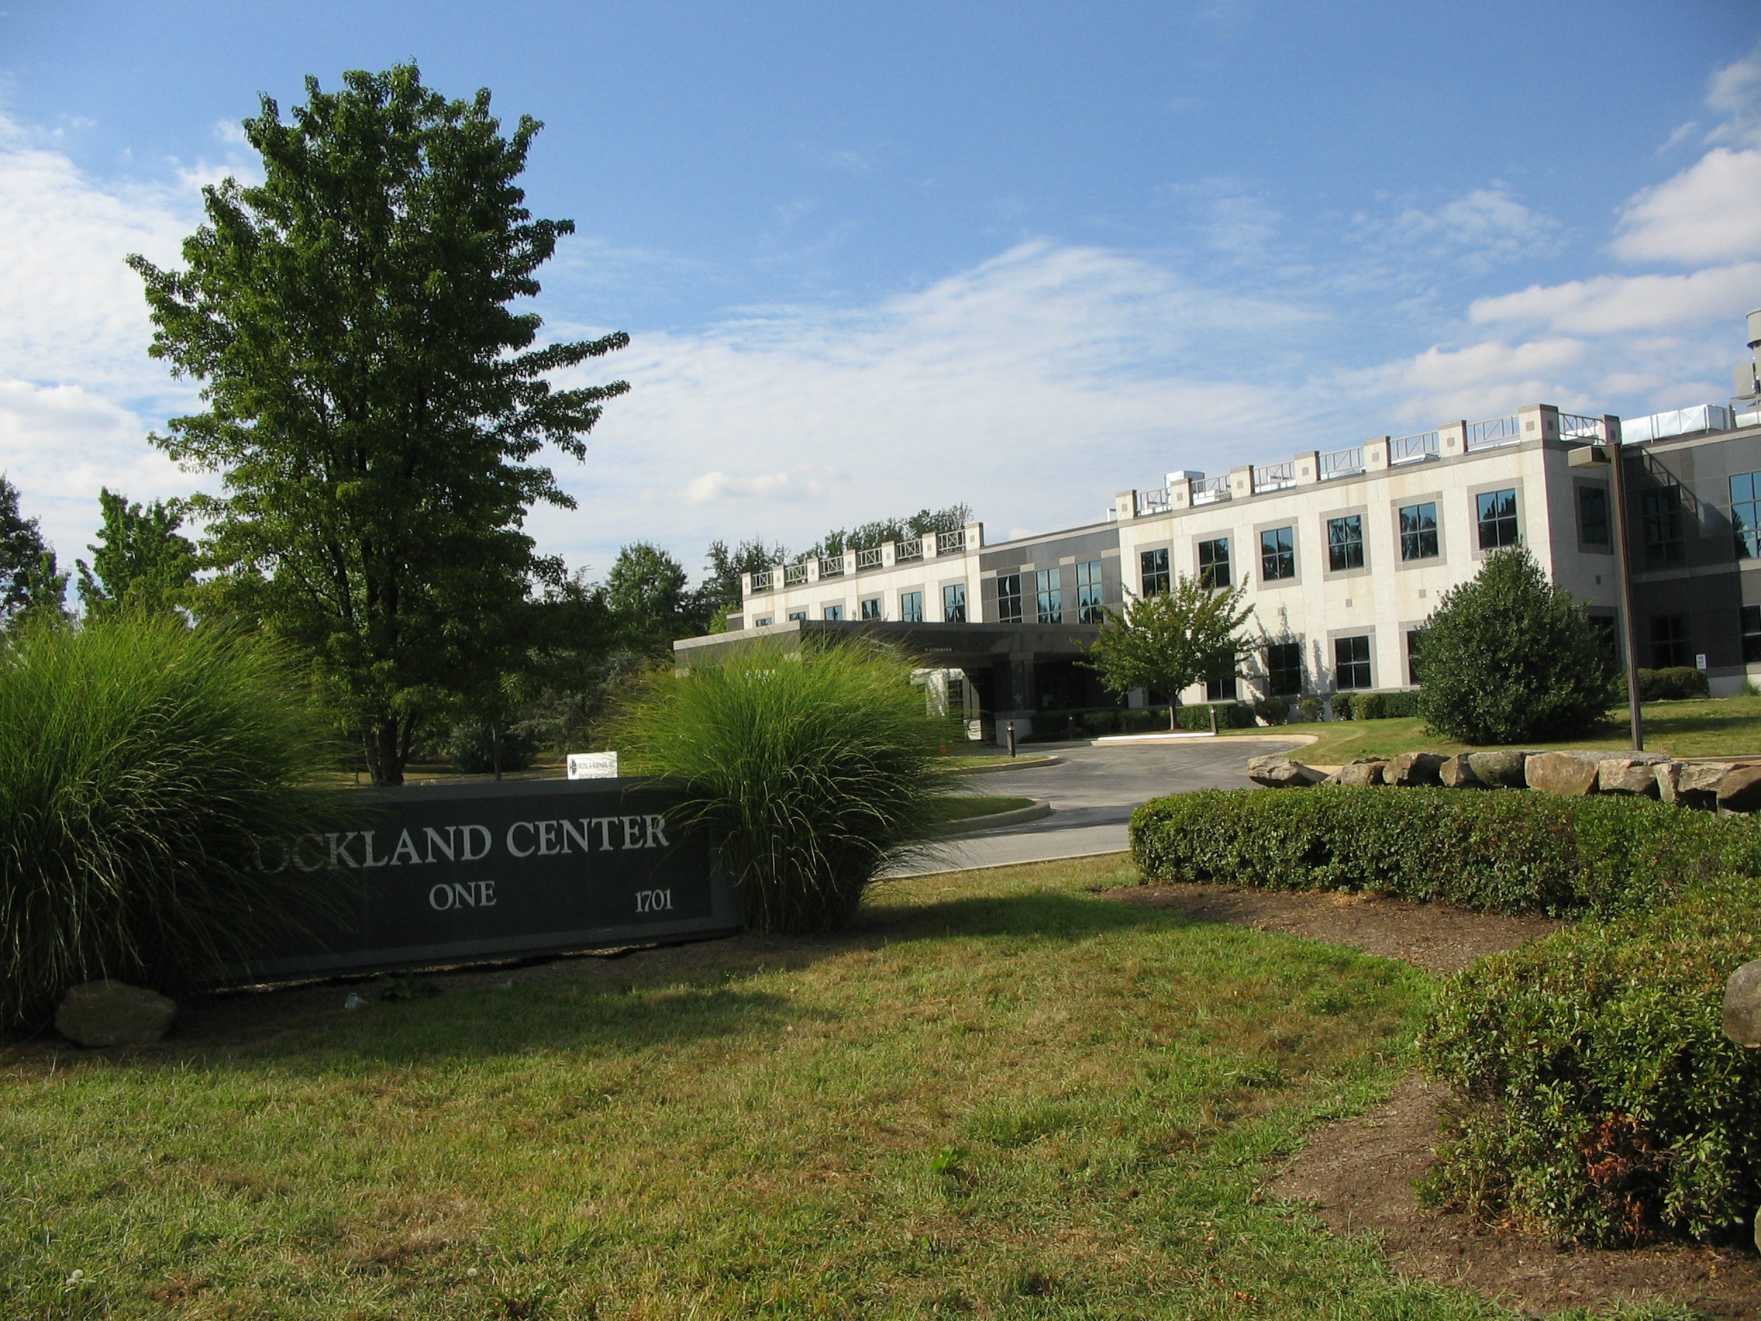
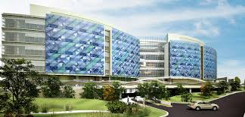

Annual INBRE PI Meeting, December 7th, 2015. NIH Bethesday MD
Sharing Resources:
Best Practices to Turn NICL into Gold
Katia Sol-Church, PhD
Director Biomolecular Core Laboratory at Nemours
Research Associate Professor of Pediatrics at TJU
Co-Director DE-INBRE Centralized Research Instrumentation Core
Member of the DE-INBRE Management Team

Slide 2

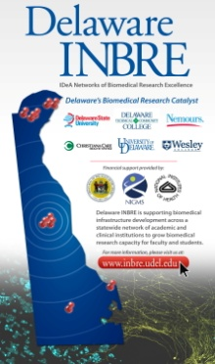


Outline
  Introducing the Delaware INBRE
    Core Facilities and Operational Models
  Network of IDeA –funded Core Laboratories
    NICL: A brief history in time
  Regional Sharing
    North Eastern Memorandum of Understanding
  What can we do collectively?
    NICL and NAIPI

Slide 3
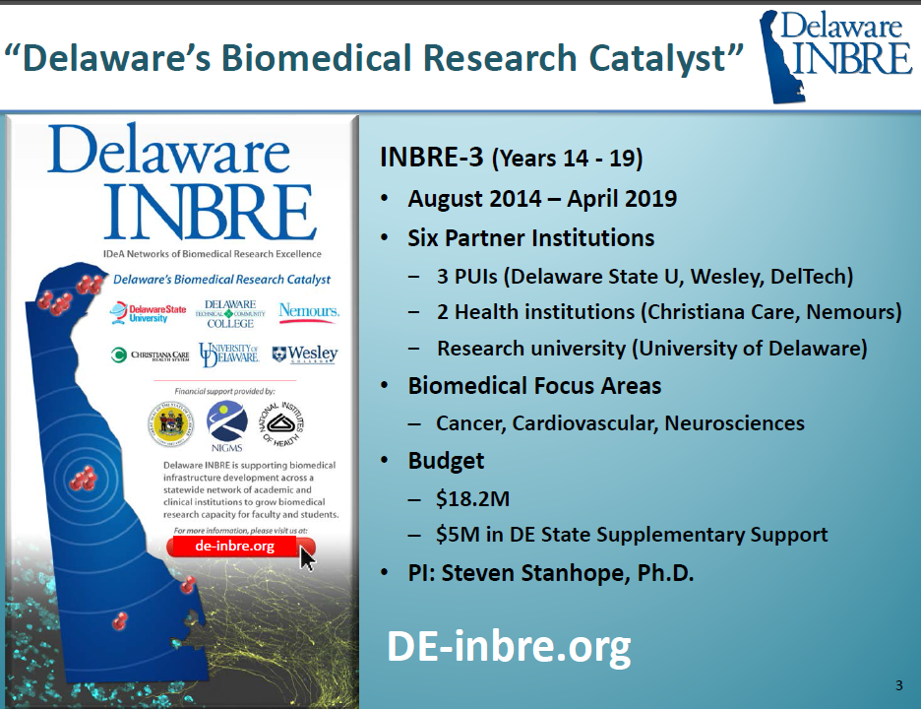

Slide 4
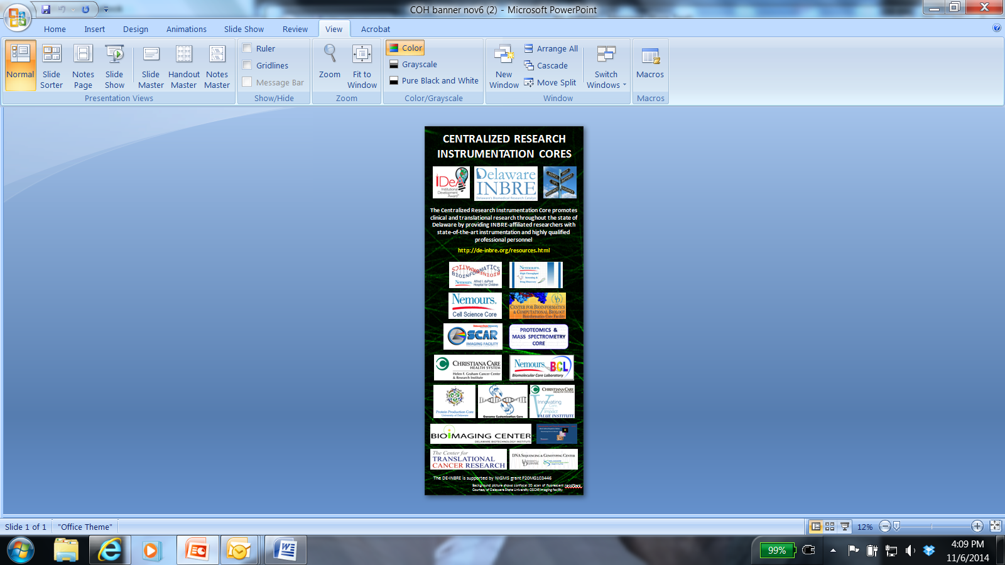
Operational Models
Paradigm Shift
Fee for Service (High volume – Client base)
  Internal Rate
  External Rate Academic
  External Commercial or Medical (CLIA/CAP)
Collaborative Model (Limited volume – Project based)
  The Core at the Heart of Biomedical Research
  The Outreach Core (mentoring students and faculty at PUI)
Mixed operational model
  Fee for service
  Collaborative
  Mentoring student and PIs

Slide 5
Balancing Act
The faculty and professionals who direct/administer core facilities are required not only to provide scientific and technical expertise, but also to manage the business requirements of a service lab
  Budgeting
  Accounting
  Marketing
  Promotion
  Reporting
  Evaluation
  Personnel management
  Long-range planning

Slide 6
NIH, NCRR 2nd Biennial National IDeA Symposium
of Biomedical Research Excellence (NISBRE)
Aug 6-8 2008, Washington DC
--------------------------------------------------------------------------------
Core Breakout Session
Provide a mentoring environment by making resources available to new COBRE/INBRE cores
Provide a forum to discuss IDeA core management issues and share information/training on new technologies
Help with long range planning and growth (sustainable cores)
Facilitate interaction/collaboration between IDeA-funded cores
Promote IDeA-wide interaction/collaboration between cores’ customers (PIs)
Notes:
6
6

Slide 7



Mission is to promote and facilitate information exchange regarding the operation and management of IDeA-funded core faciltities NICL
Let’s get organized !
National Network of IDeA-funded Core Laboratories
Resource
Sharing
Tim
Hunter

Slide 8
NICL : Providing a Voice for the Cores
Establish Tools to Promote Information Exchange
  NICL Website (www.niclweb.org)
  VGN core Database
  NIH invites to participate in Core Management Workshops
Provide Forums for Core Networking and Education
  Leverage through
    ABRF an international association of core facilities (First Annual Meeting)
    NERLSCD Regional Core Director Meeting (technology breakout)
    IDeA conferences: Core track session sand workshops at NERIC, NISBRE
Promote Resource Sharing (2010)
  Establish “Fee Waivers” or “special pricing” to encourage Network interactions lower prices (subsidized). “In-kind” services between core facilities
  Road block might be institutional: not set-up for easy sharing (e.g. purchasing dept. have difficulties dealing with PO’s for outside customers).
  Memo of Understanding (MOU): a standard document used for resource sharing by all cores in the NCRR Network (Tim Hunter)

Slide 9
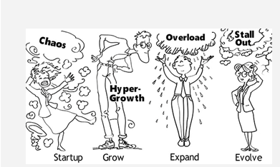
The learning curve
Operations & Facilities Planning Evolving Technology Data Management & Sharing Future Planning
            Maintaining Technical Currency Sustainability

Slide 10
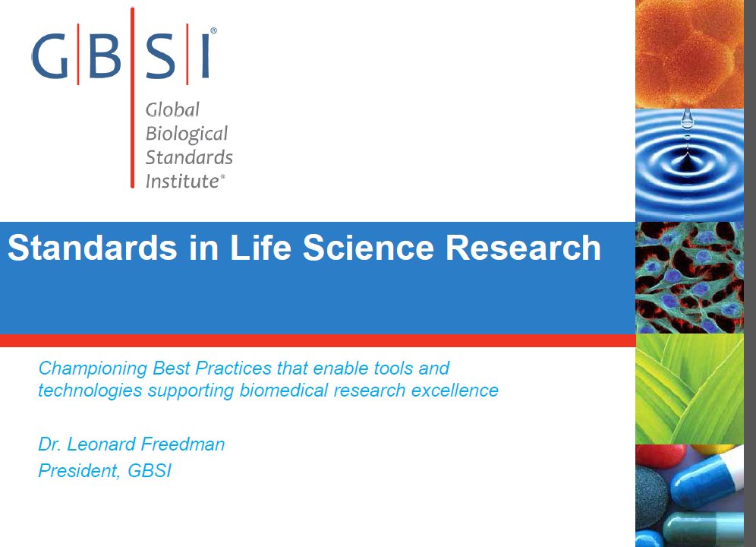
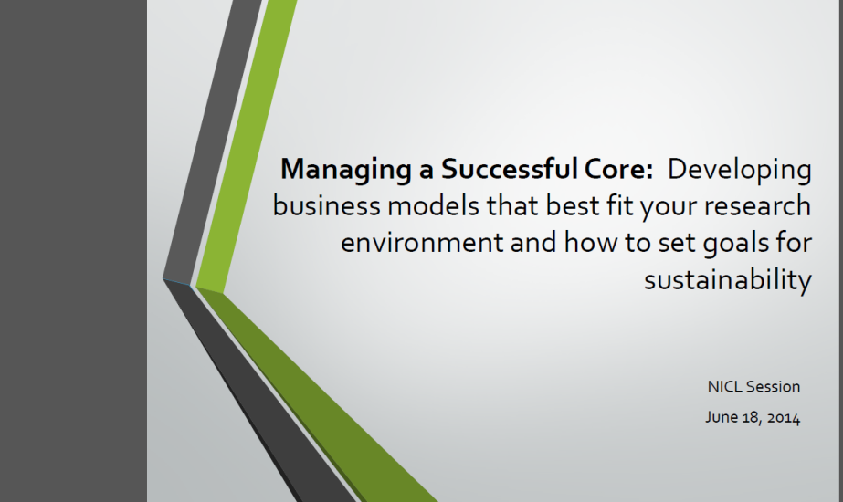
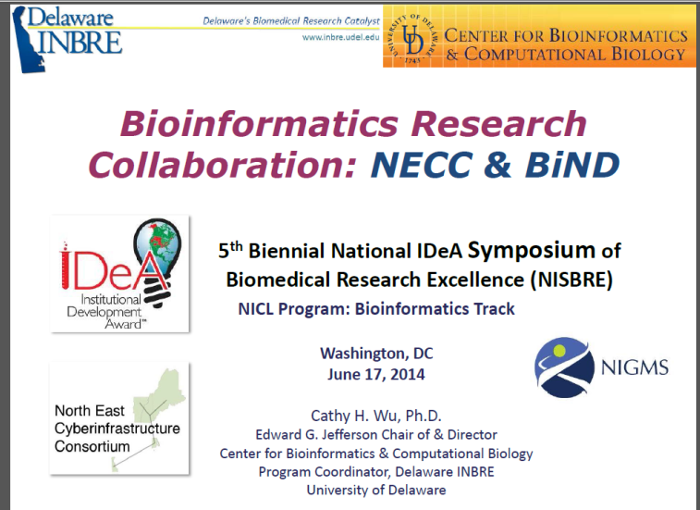
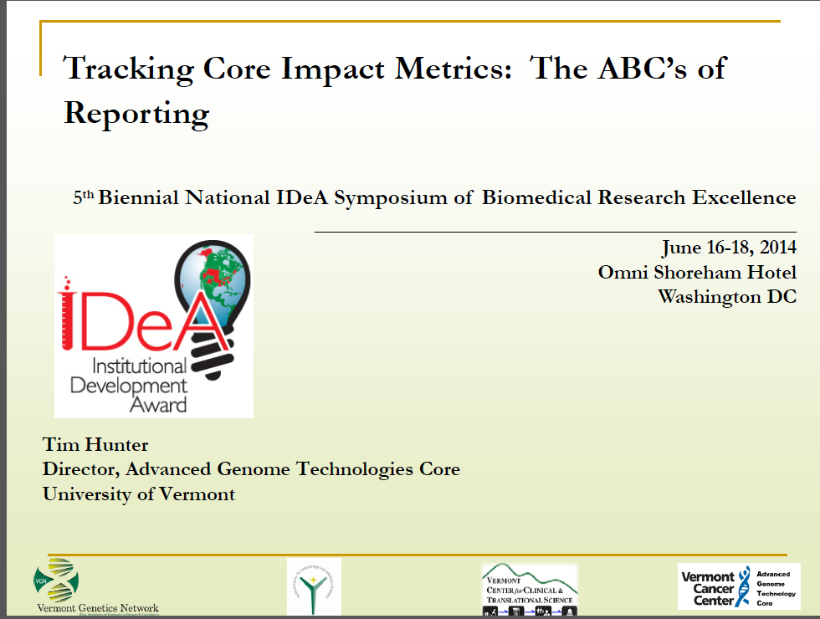
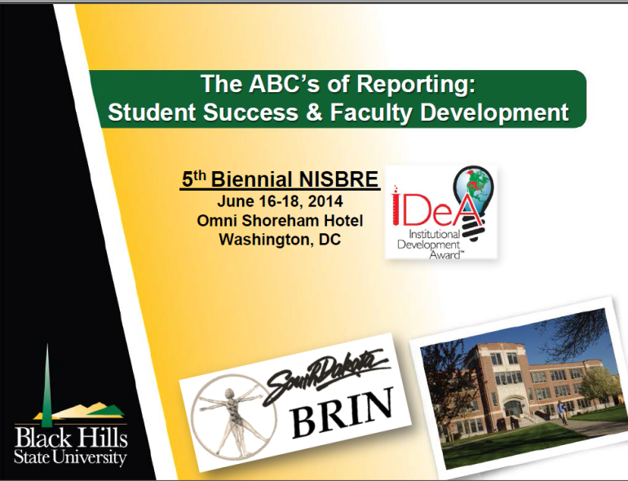

Slide 11
NICL : Providing a Voice for the Cores
Establish Tools to Promote Information Exchange
  NICL Website (www.niclweb.org)
  VGN core Database
  Invitation to NIH on Core Management
Provide Forums for Core Networking and Education
  Leverage through *ABRF, an international association of core facilities *Regional Core Director meetings (NERLSCD), IDeA conferences (NERIC, NISBRE)
Promote Resource Sharing (2010)
  Establish “Fee Waivers” or “special pricing” to encourage Network interactions lower prices (subsidized). “In-kind” services between core facilities
  Road block might be institutional: not set-up for easy sharing (e.g. purchasing dept. have difficulties dealing with PO’s for outside customers).
  Memorandum of Understanding (MOU): a standard document used for resource sharing by all cores in the NCRR Network (Tim Hunter)

Slide 12
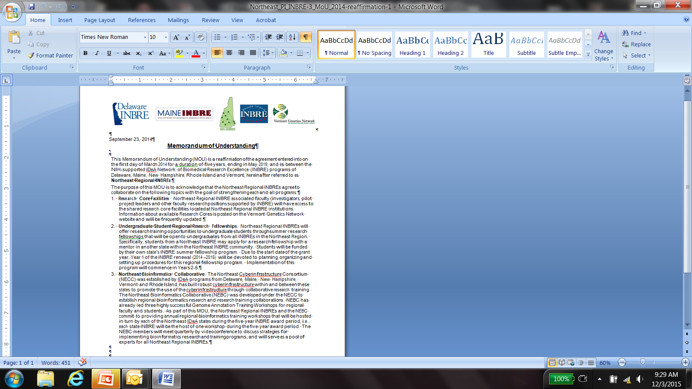
North
East
Regional
MOU

Slide 13
MOU DISCUSSION during NERIC 2015 (Bar Harbor, ME)
What type of things can we do as cores to strengthen partnership?
How can we capitalize on unique distributive strength across the north east INBREs
Who’s Sharing?
What?
How?
Can/Should We?

Slide 14
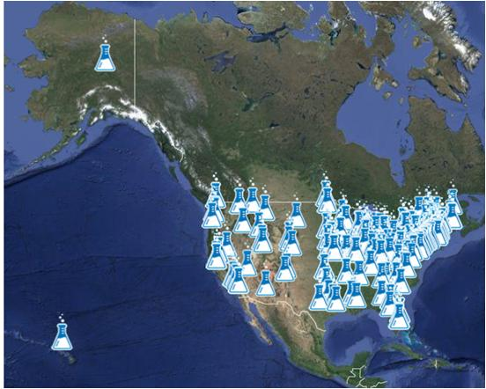
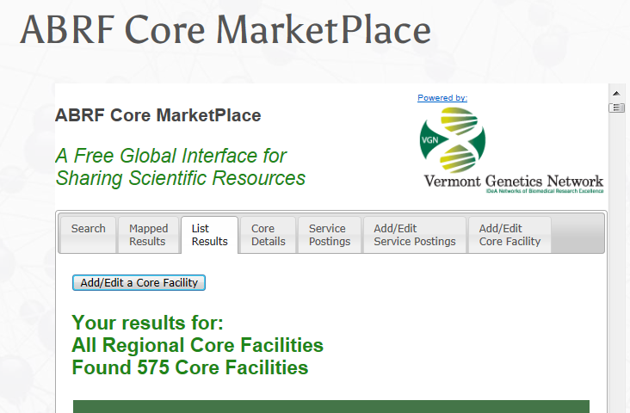
Database by the numbers
575 Total Cores listed
207 members of ABRF
149 in IDeA States
121 NICL Affiliates
92 COBRE (43 in North East IDeA)
75 INBRE (37 in North East IDeA)
North East Regional “One of a Kind”
CRISPR/Casp9 DE
Speed Congenic NH
Next Generation Sequencing PGM DE
Next Generation Sequencing PacBio DE
Small-Angle Neutron Scattering VT
Bioinformatics Hubs : Genomics DE
Proteomics VT

Slide 15
Share best practice
  Cores as mentors (travel funds, educational funds)
    Technical training of core staff (site visit, training on site)
    Core Operation (Business models, price setting, how find market for services, teach path to sustainability)
  Stream line common processes
    Adopt similar forms and application process for Core fee waivers/Core Center Access Award (DE and ME)
    Share Core user forms to increase compliance to NIH citation and publication guidelines. (VT and DE)
    Share SOPs
  Identify and adopt tools (Software LIMS) that enable cores to do a better job at impact monitoring and reporting (metrics, metrics , metrics…)

Slide 16
  What else can we do collectively?
What type of activities can we do as cores to strengthen IDeA partnership beyond the charge of the North East INBRE MOU
  INBRE/COBRE/CTR
  Alliance between the NICL and NAIPI to promote sharing starting at the Regional → National

